Slide 1



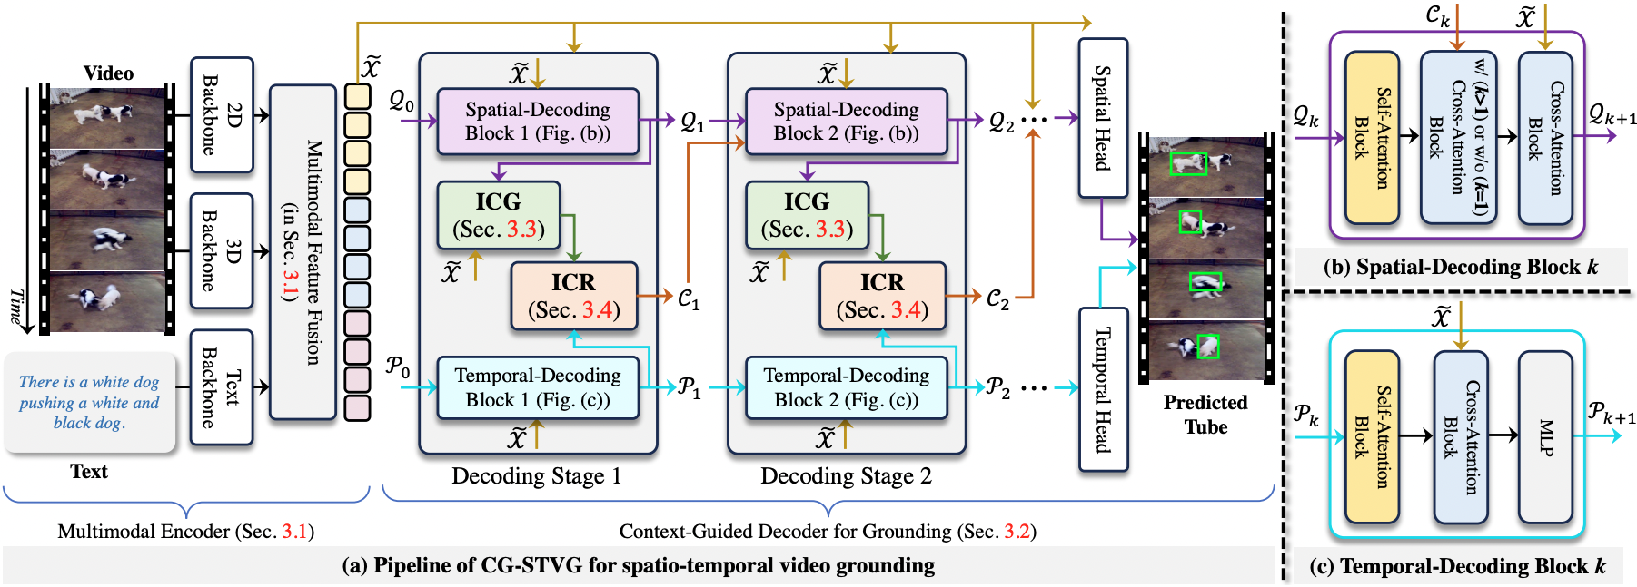
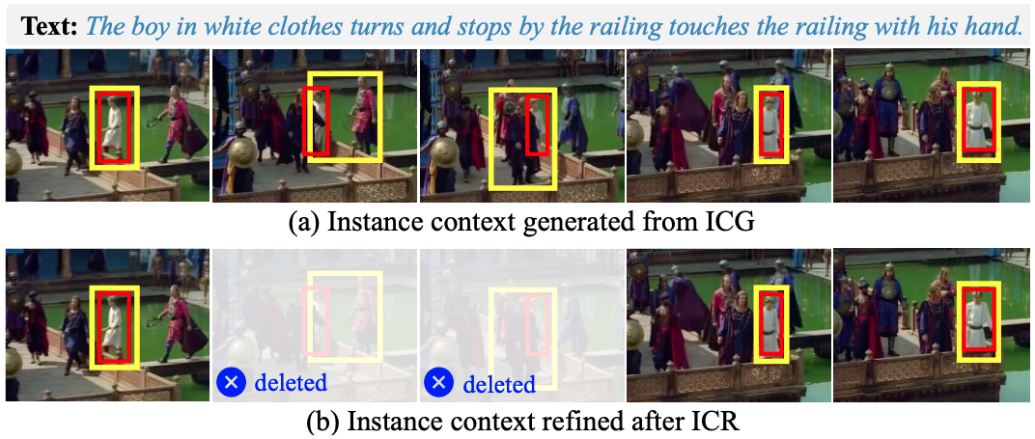
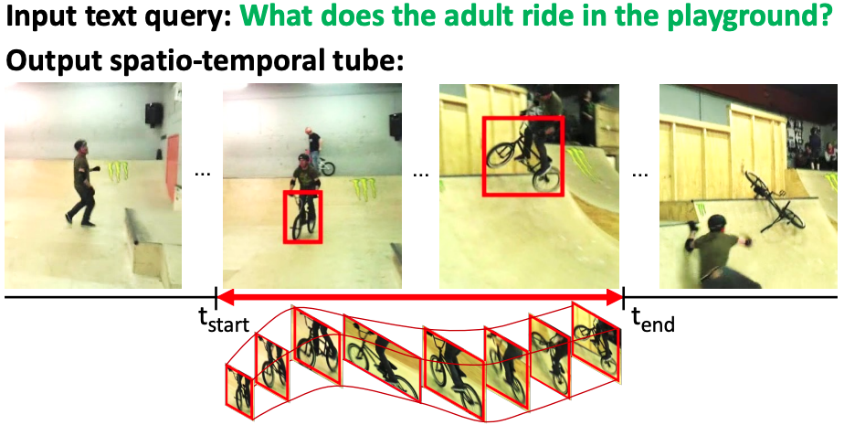
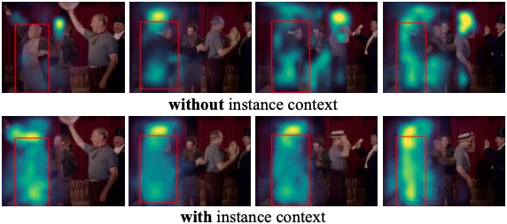
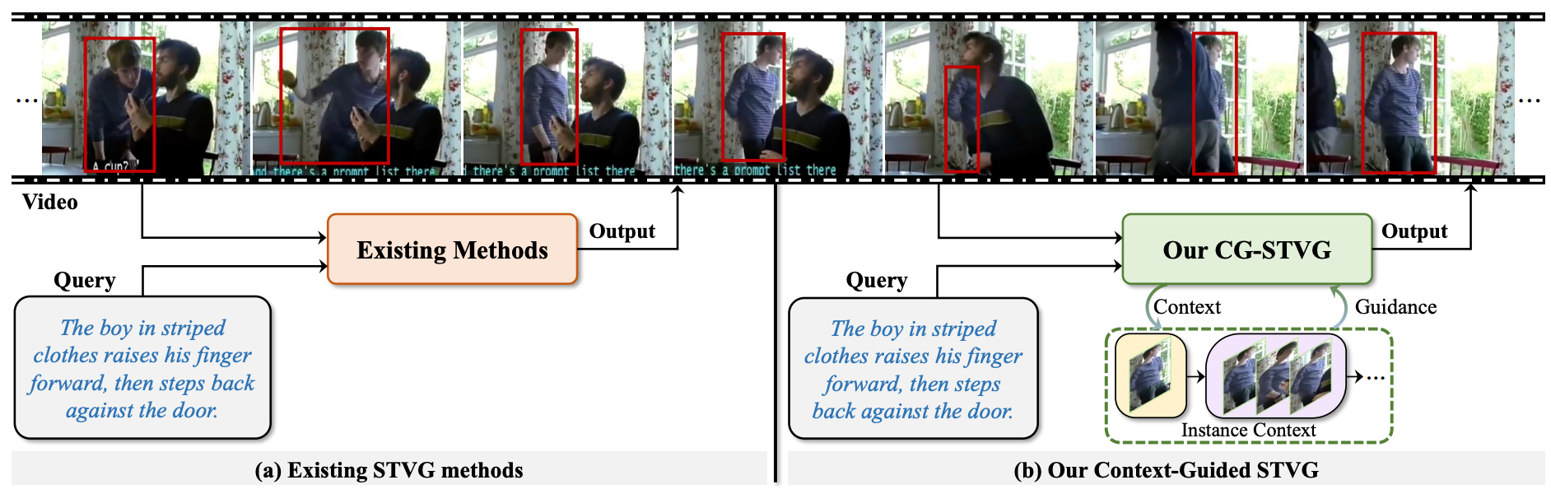
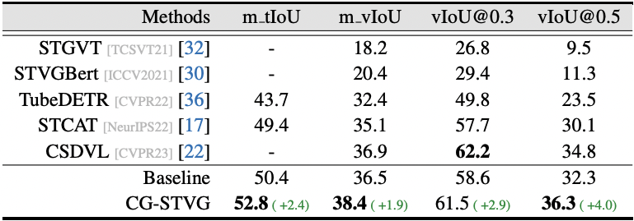
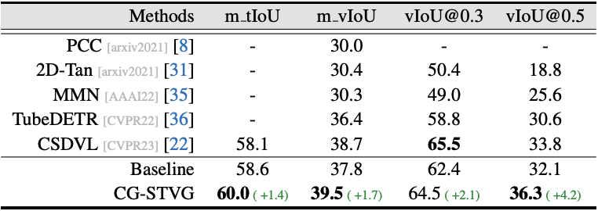
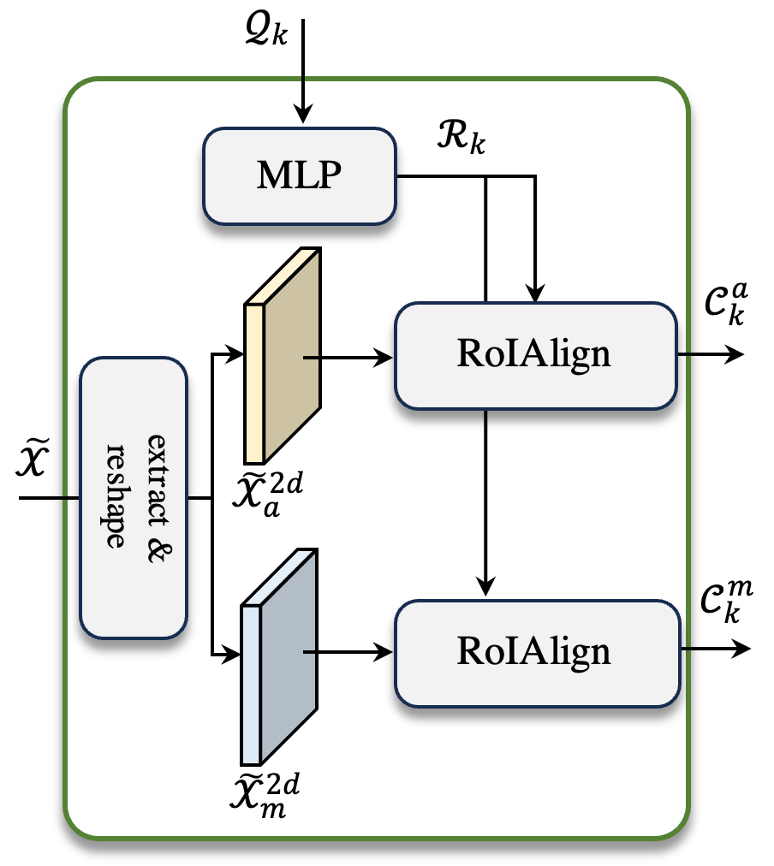
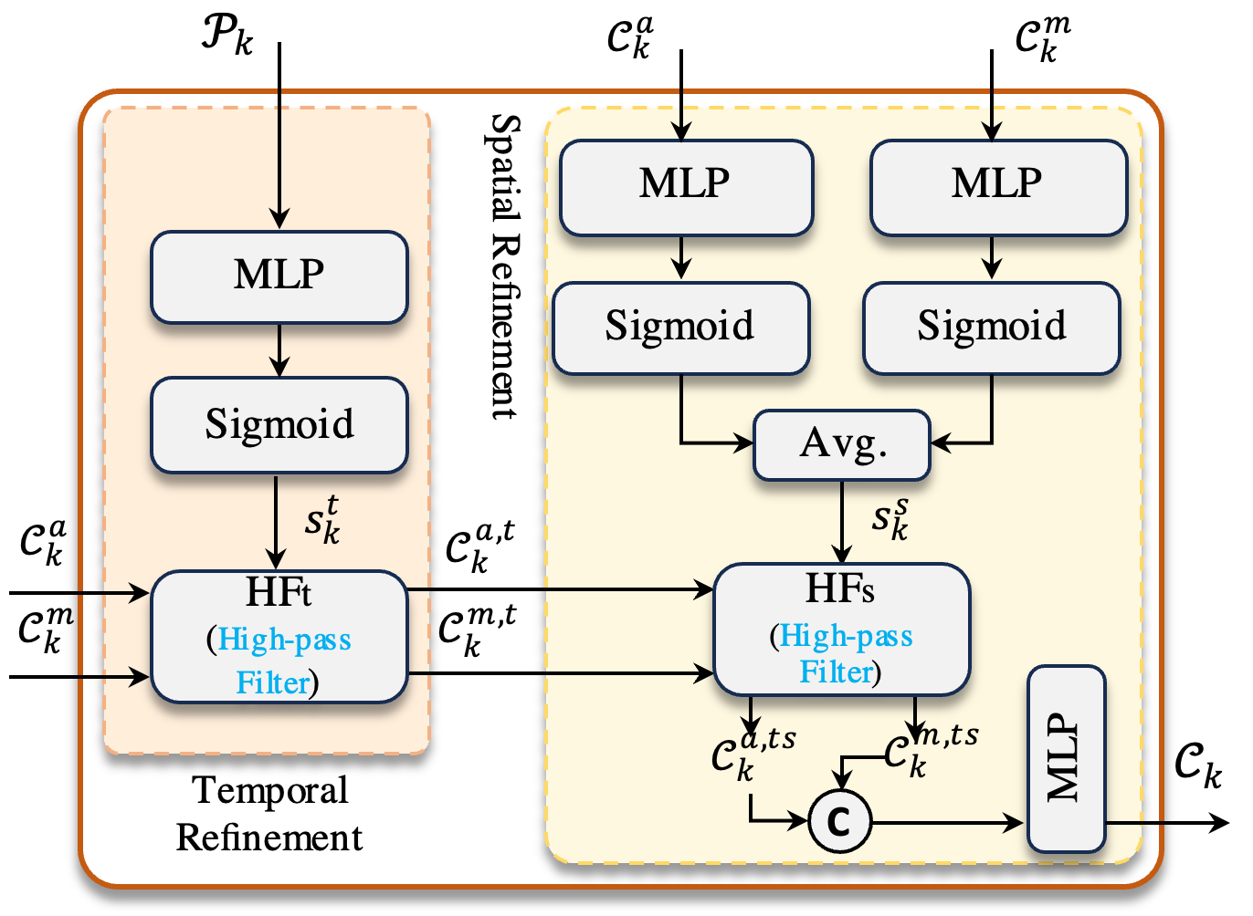
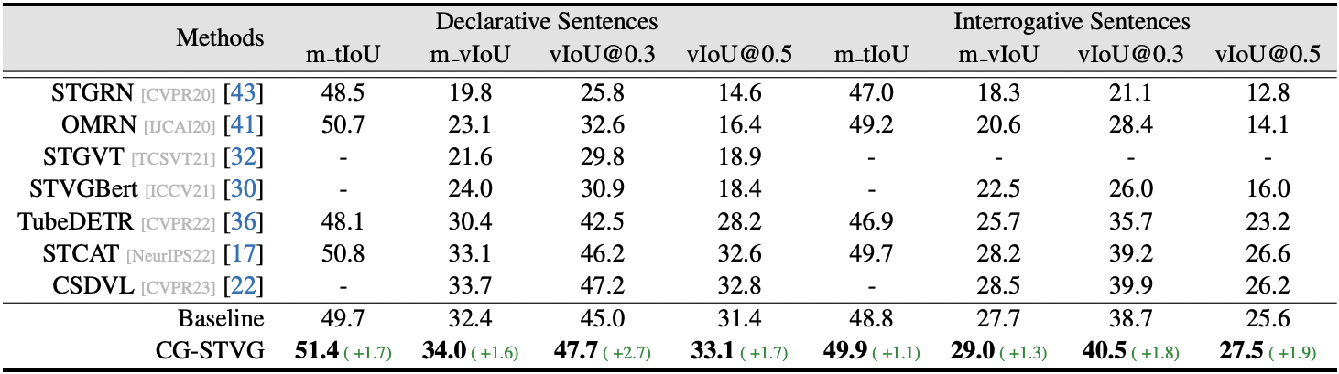


Context-Guided Spatio-Temporal Video Grounding
Context-Guided Spatio-Temporal Video Grounding
Xin Gu^{1,3*} Heng Fan^{2*} Yan Huang² Tiejian Luo¹ Libo Zhang^{1,3†} （*equal contributions, †Corresponding author）
¹University of Chinese Academy of Sciences ²University of North Texas ³Institute of Software Chinese Academy of Sciences
Spatio-Temporal Video Grounding
The Proposed Methodology
Analysis
What is spatio-temporal video grounding (STVG)?
Illustration of ICG and ICR
STVG aims to localize the object of interest in an untrimmed video with a spatio-temporal tube given a free-form textual query
Red box:
target object of interest;
Yellow box: generated target box for instance visual context mining
Input text query:
What does the adult ride in the playground?
Output:
A spatio-temporal tube
(Yang et al, CVPR’2022)
Attention maps
spatio-temporal tube
Instance Context
Text: The bald man waves his hat, then turns and walks away.
Motivation
Figure 2: Overview of the proposed context-guided spatio-temporal video grounding
Context-guided spatio-temporal video grounding: Mining instance visual context from the video to guide spatio-temporal target localization (Fig. 2)
Red box:
target object of interest;
Feature extraction and interaction for video (2D appearance and 3D motion features) and text
Spatial- and temporal-decoding for target localization
Instance visual context is mined during decoding, via ICG and ICR, and used for guiding localization
Experiments
Core modules: ICG for instance context generation and ICR instance context refinement
Figure 1: Comparison of existing methods (a) with our context-guided STVG (b)
Spatial query
Temporal query
Existing STVG Methods (Fig. 1 (a))
Text query as the only cue for target localization
Insufficient to distinguish foreground object in complex scenes
Enhance text with more fine-grained information: (i) laborious; (ii) more computational overheads; (iii) still difficult to describe visual details.
Instance
appearance context
Table: Results on HCSTVG-v1 test set (%)
Table: Results on HCSTVG-v2 test set (%)
Code/
Results
Our context-guided STVG (Fig. 1 (b))
A famous adage: “A Picture Is Worth a Thousand Words”
Exploit visual information of the object to offer a guidance, directly from the vision perspective, for improving STVG
Instance
motion context
Instance
context
Figure 4: Illustration of ICR
Visual context has significantly improved the performance!
Figure 3: Illustration of ICG
Table: Results on VidSTG test set (%)

